Slide 1
Closing the Gap: Improving Vision Transformers on Small‑Scale Image Classification
Will Chiappetta, Dylan Benson, and Nicholas Cavallaro | Group 5

Slide 2
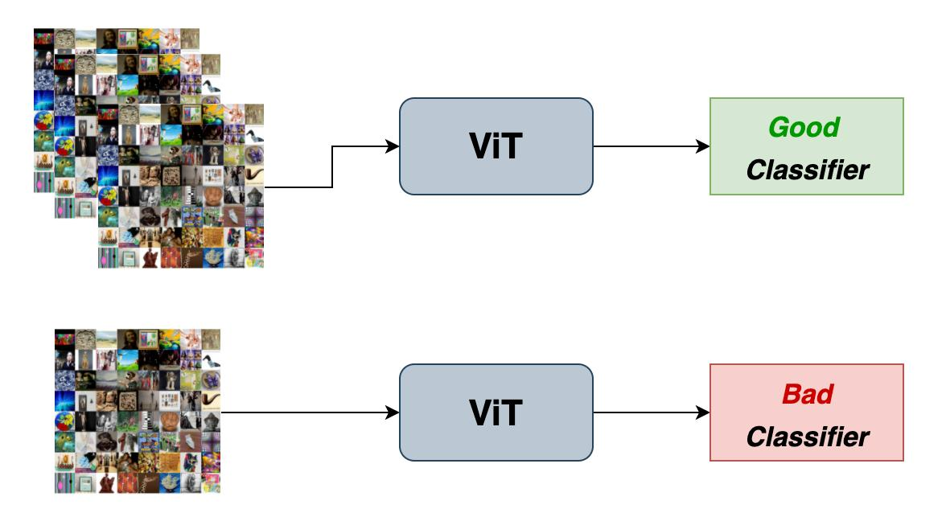
Problem Statement:
Vision Transformers perform poorly on small, low-resolution datasets like CIFAR-10/100 compared to CNNs such as ResNet-18. The problem is how to improve ViT so it can effectively learn from limited spatial information and become competitive on these datasets.
Notes:
Will

Slide 3

Motivation:
Transformers have achieved state-of-the-art results in vision tasks
Potential to replace CNNs in computer vision
However, performance drops significantly on small datasets
Why this matters:
Many real-world applications use limited data
Understanding ViT limitations improves model selection
Adapting ViTs could make them more widely applicable
Goal:
Bridge the performance gap between ViT and CNNs on CIFAR
Notes:
Will

Slide 4
Existing Related Approaches
Source | Focus | Key Differences from Our Project
GitHub – ra1ph2/Vision‑Transformer | Implements multiple ViT and ResNet variants in PyTorch, including pretrained and hybrid models, and compares them on CIFAR‑10/100. | We built a custom CLS‑free ViT in TensorFlow, trained both models from scratch under one unified pipeline, and focused on patch size, stability, and t‑SNE analysis.
Comparative Study Of Data Efficiency In Vision Transformer And ResNet-18 Architecture (Hukari, 2024) | Studies how data efficiency differs between ViT and ResNet‑18 by training on reduced‑size datasets and measuring performance as available data decreases. | We train both models from scratch on full CIFAR‑10/100 datasets and focus on patch size, training stability, and embedding analysis rather than data‑efficiency experiments.
When Vision Transformers Outperform ResNet Without Pre-Training Or Strong Data Augmentations (Chen, 2022) | Shows that ViTs can outperform ResNets on by using sharpness‑aware optimization and carefully tuned training, even without pretraining or heavy augmentation on ImageNet-scale data. | We do not use sharpness‑aware optimization or ImageNet‑scale training; we train both models from scratch on CIFAR‑10/100 under one unified pipeline and focus on patch size, stability, and t‑SNE analysis.
Notes:
Will

Slide 5
Approaches:
3. Ensuring Fair Comparison with CNN Baseline
Both ViT and ResNet were trained under identical conditions:
Same data augmentation pipeline
Same optimizer (AdamW with weight decay)
Same cosine learning rate schedule
Same loss function (with label smoothing)
Ensures performance differences come from architecture, not training setup
4. Evaluating Representation Quality (Beyond Accuracy)
Accuracy alone does not explain model behavior
We analyze learned features using:
Embedding extraction from trained models
t-SNE visualization for 2D projection
Goal: Compare how well each model:
Separates classes
Learns structured feature representations
1. Improving Spatial Representation
CIFAR images (32×32) provide very limited spatial resolution
Large patches result in loss of fine-grained information
We increase token granularity to better capture local visual features
Goal: Enable ViT to learn meaningful patterns from small images
2. Stabilizing Transformer Training
Baseline ViT showed unstable training and weaker convergence
Transformers lack CNN inductive biases → harder to train on small datasets
We simplify and stabilize the architecture to improve:
Consistency across epochs
Generalization performance

Slide 6
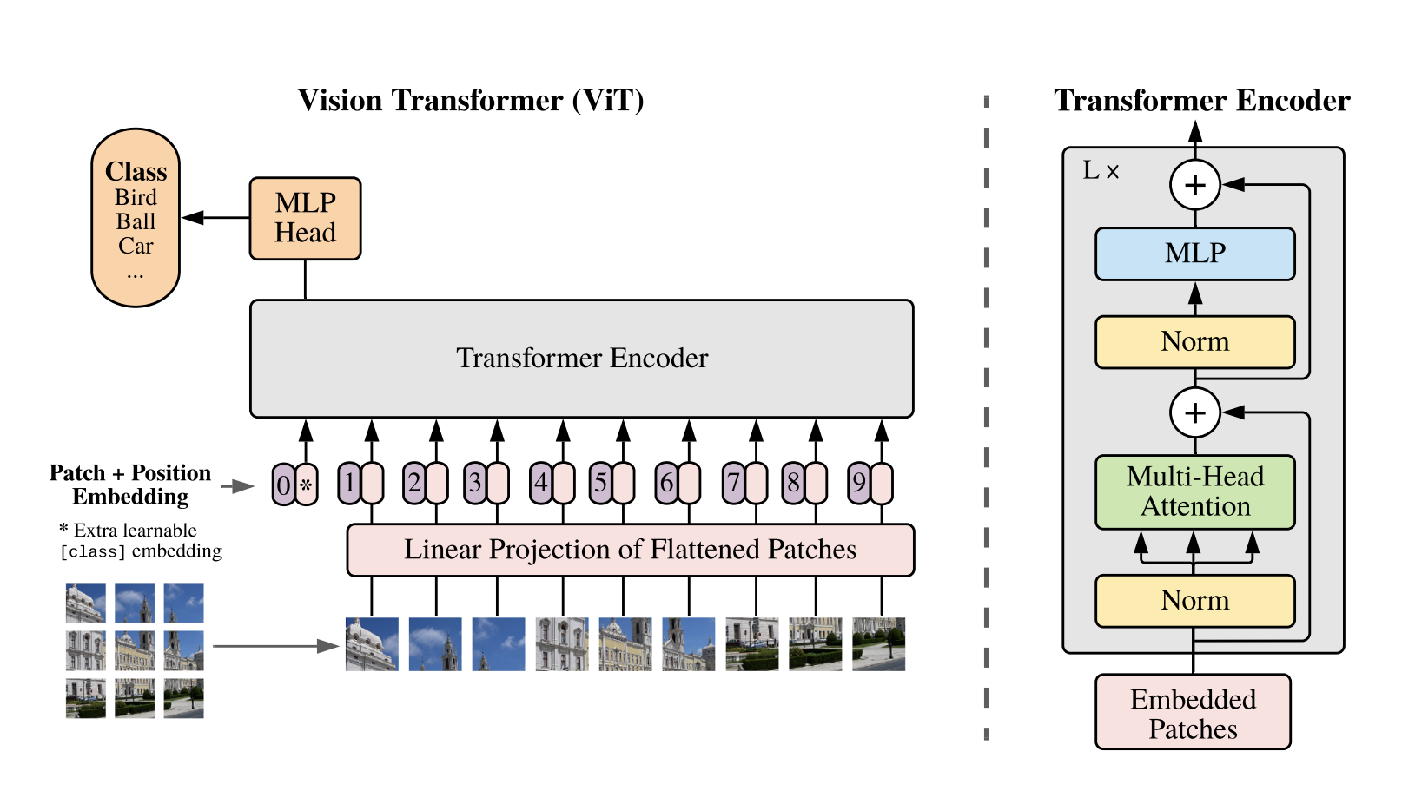

Method:
CLS-free ViT implementation
Removed CLS token for stability
GlobalAveragePooling over tokens
Fully Keras‑compatible (no symbolic tensor errors)
Patch size optimization
Reduced patch size to 8×8 for CIFAR resolution
Increased token granularity
Unified training pipeline
Same augmentation, optimizer, LR schedule, and loss for both models
Ensures fair comparison
Embedding extraction and t‑SNE visualization
Built custom embedding model
Compared feature separability between ViT and ResNet
t-SNE (t-Distributed Stochastic Neighbor Embedding): a non-linear machine learning algorithm used for dimension reduction, primarily to visualize complex, high-dimensional datasets in 2D or 3D plots

Slide 7
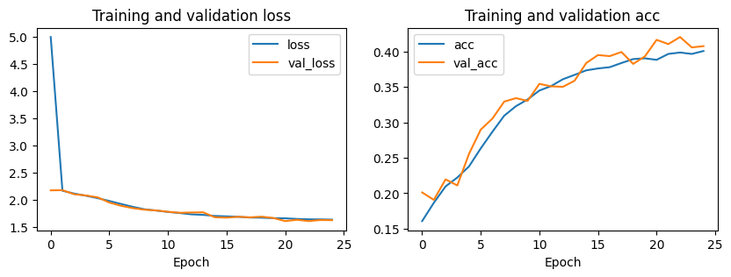
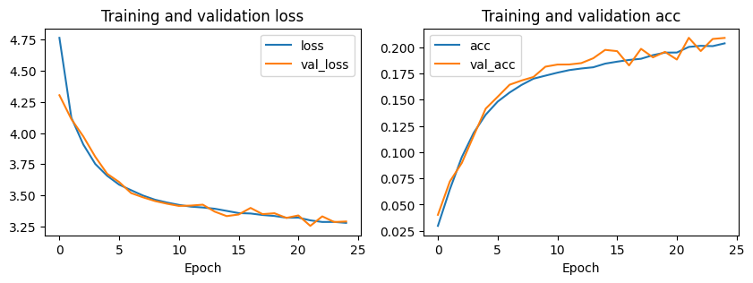
ViT Baseline:
CIFAR‑10
Smooth loss decrease and tightly aligned train/val curves: stable learning, low overfitting
Accuracy improves steadily but plateaus early
Overall performance modest (~40%) but consistent with ViT trained from scratch
CIFAR‑100
Higher loss and slower convergence: dataset complexity impacts ViT more strongly
Train/val curves remain close and accuracy improves steadily but plateaus early again
Accuracy remains low (~20%): ViT struggles without large‑scale pretraining
CIFAR 10:
CIFAR 100:

Slide 8
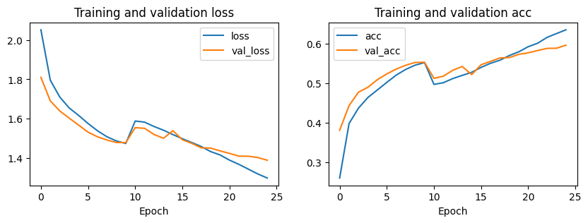
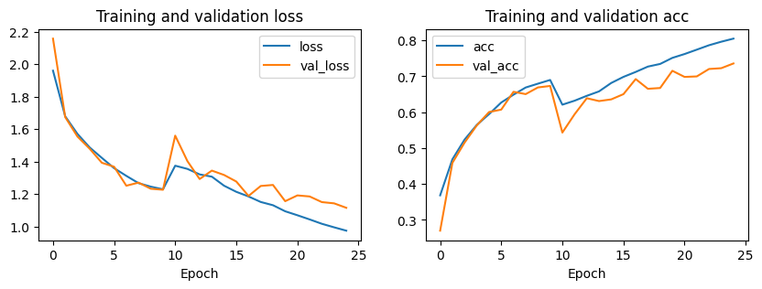
Observations (CIFAR-10):
Steady Convergence: Training shows consistent improvement, with accuracy peaking near 80% over 25 epochs.
Training Instability: A significant loss spike and accuracy dip occurs around Epoch 10, indicating potential optimizer instability or learning rate sensitivity.
Overfitting Trends: Validation loss begins to diverge from training loss in the later stages, suggesting the model is starting to memorize the training set.
Performance Ceiling: The "plateau" behavior in validation accuracy suggests that further gains may require advanced data augmentation or longer training schedules.
Baseline ViT: 40.1%
Improved ViT: 63.5%
ResNet: 80%
ViT:
ResNet:
Notes:
Baseline- ViT:40% ResNet:80%
Improved- ViT:63.5% ResNet:80%

Slide 9
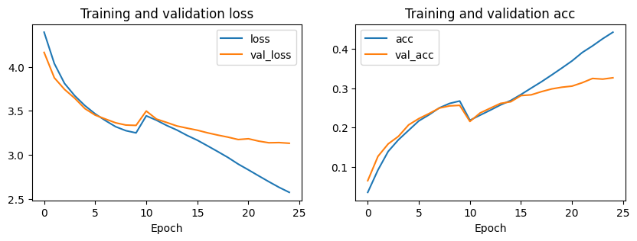
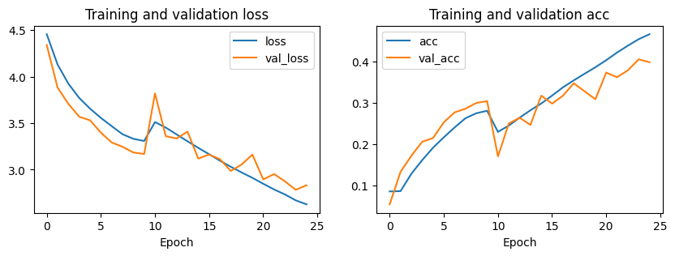
Observations (CIFAR-100):
Convergence & Accuracy: Consistent training progress across 25 epochs, though peak validation accuracy is significantly lower (~20-35%) than CIFAR-10.
Recurrent Instability: Notable gradient spikes around Epoch 10 mirror the CIFAR-10 results, suggesting a systematic issue with the learning rate schedule.
Severe Overfitting: A widening gap between training and validation metrics indicates the model is struggling to generalize to 100 different classes.
Performance: Despite similar curve shapes, the loss values remain much higher, reflecting the increased complexity of the CIFAR-100 dataset.
Baseline ViT: 20.4%
Improved ViT: 44.2%
ResNet: 46.5%
ViT:
ResNet:
Notes:
Will
Baseline- ViT:20.4% ResNet:46.5%
Improved- ViT:44.2% ResNet:46.5%

Slide 10
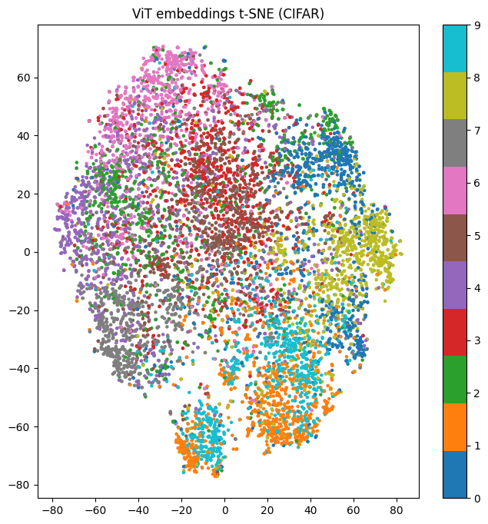
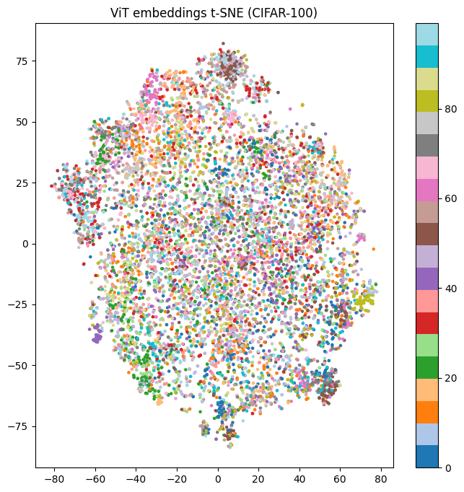
ViT Embeddings t-SNE (CIFAR-10 vs CIFAR-100)
Separation: CIFAR-10 (left) shows distinct, isolated clusters; CIFAR-100 (right) exhibits high overlap.
Granularity: Clearer decision boundaries in CIFAR-10 vs. high semantic "noise" in CIFAR-100.
Complexity: Increased label density in CIFAR-100 results in more crowded feature representations.
Performance: Highlights the difficulty of fine-grained classification compared to coarse categories.

Slide 11
Results:
CIFAR-10
Both models train smoothly
ResNet converges faster and achieved a higher accuracy
ViT is competitive but slightly behind
Training curves show:
Stable loss decrease
Some overfitting
Good gerneralization
CIFAR-100
Both models struggled more
ResNet outperforms ViT slightly
ViT learns slower and reaches lower accuracy
Reasons:
ViT needs more data
CIFAR-100 is fine-grained (less data per category)
CNN inductive bias helps more

Slide 12

Challenges
Finding a topic that was different from previous work
Getting ViT to improve in accuracy past ResNet
Both models struggled more on CIFAR-100 (this can be explored more in the future)

Slide 13

Conclusion and Future Work:
Conclusion
ViT can learn on CIFAR‑10/100 but:
Needs careful training
Underperforms ResNet without pretraining
CNNs remain superior for small datasets
Future work
Try smaller patch sizes (4x4)
Try strong augmentation to reduce overfitting and improve generalization
Try regularization with more epochs

